Slide 1
Predict Default Risk of Small Businesses in USA
Objective: “Should Loan be Approved or Denied for small business borrowers?”
Dataset: related to the U.S. Small Business Administration (SBA)
Data Shape: 899164 rows x 27 columns
Tools: Pandas & for presentation-Tableau
Algorithm: Logistic Regression (classification) to predict probability of default
Motivation: My domain and dataset is pretty much aligned to real-world scenario
Source: https://www.kaggle.com/mirbektoktogaraev/should-this-loan-be-approved-or-denied?select=SBAnational.csv

Slide 2
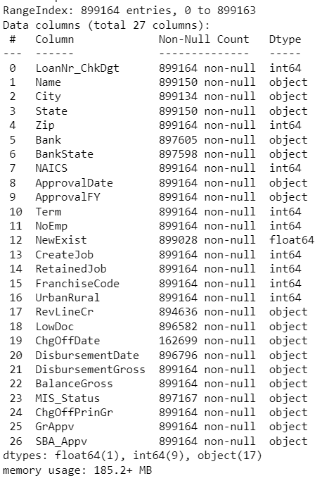
Srini Narayanan

